Slide 1

PROJECT PHASE 1
Team Members: Manjot Kaur, Waryam Kaur
Course Name: CMPT 3510
Instructor Name: Mohammad Ajallooeian

Slide 2

PROJECT OVERVIEW
Predicting Emissions from the Fossil Fuel Electricity Generation Sector Post-Coal Phase-Out (2030)
Objective: To analyze historical emissions data from coal power plants and develop a time series dataset that enables classification and future prediction of emissions trends if coal plants are entirely phased out by 2030.
Phase 1 Goals:
Transform the dataset into a time series format compatible with machine learning.
Develop a preliminary classification model by categorizing emissions into Low, Medium, and High.
Explain and document the data transformation, feature engineering, and classification approach.

Slide 3
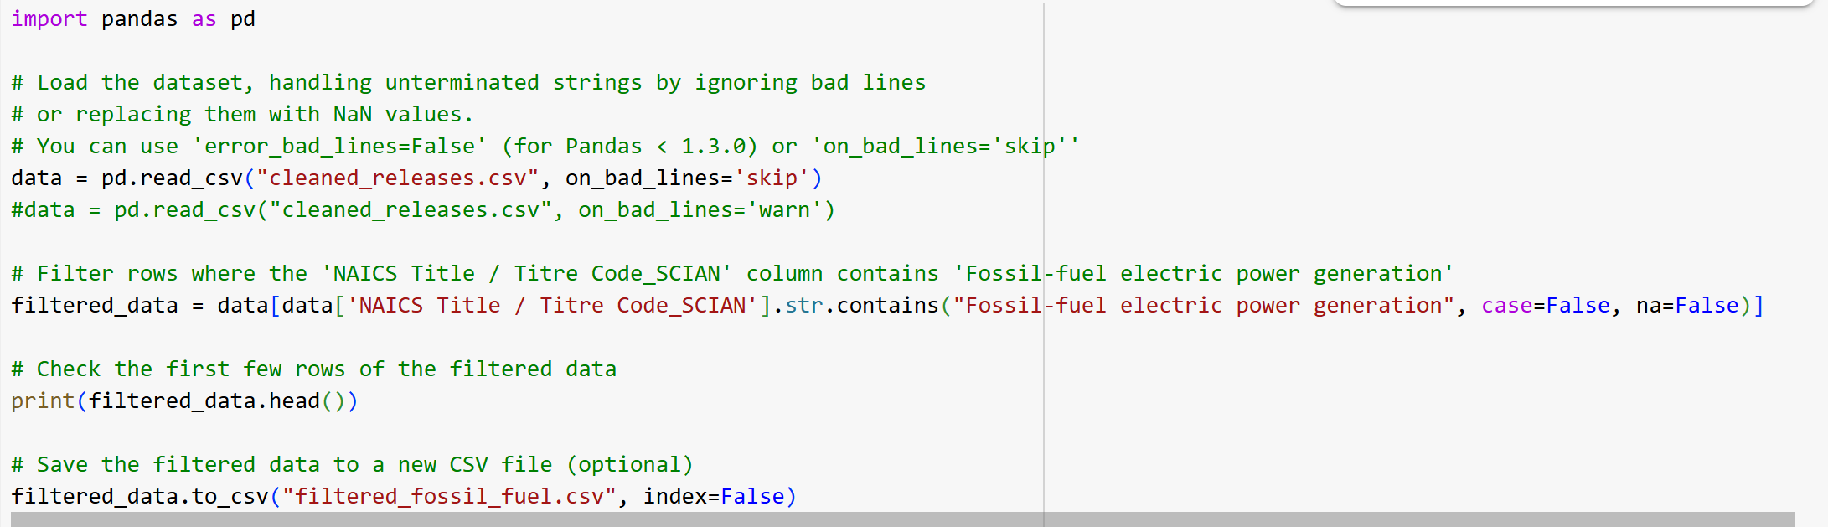
DATA LOADING & FILTERING

Slide 4
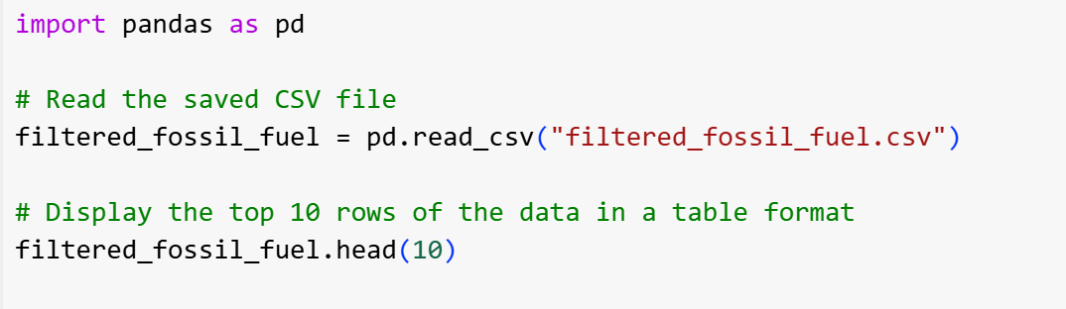
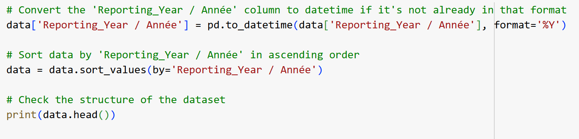
Viewing and Sorting Data

Slide 5

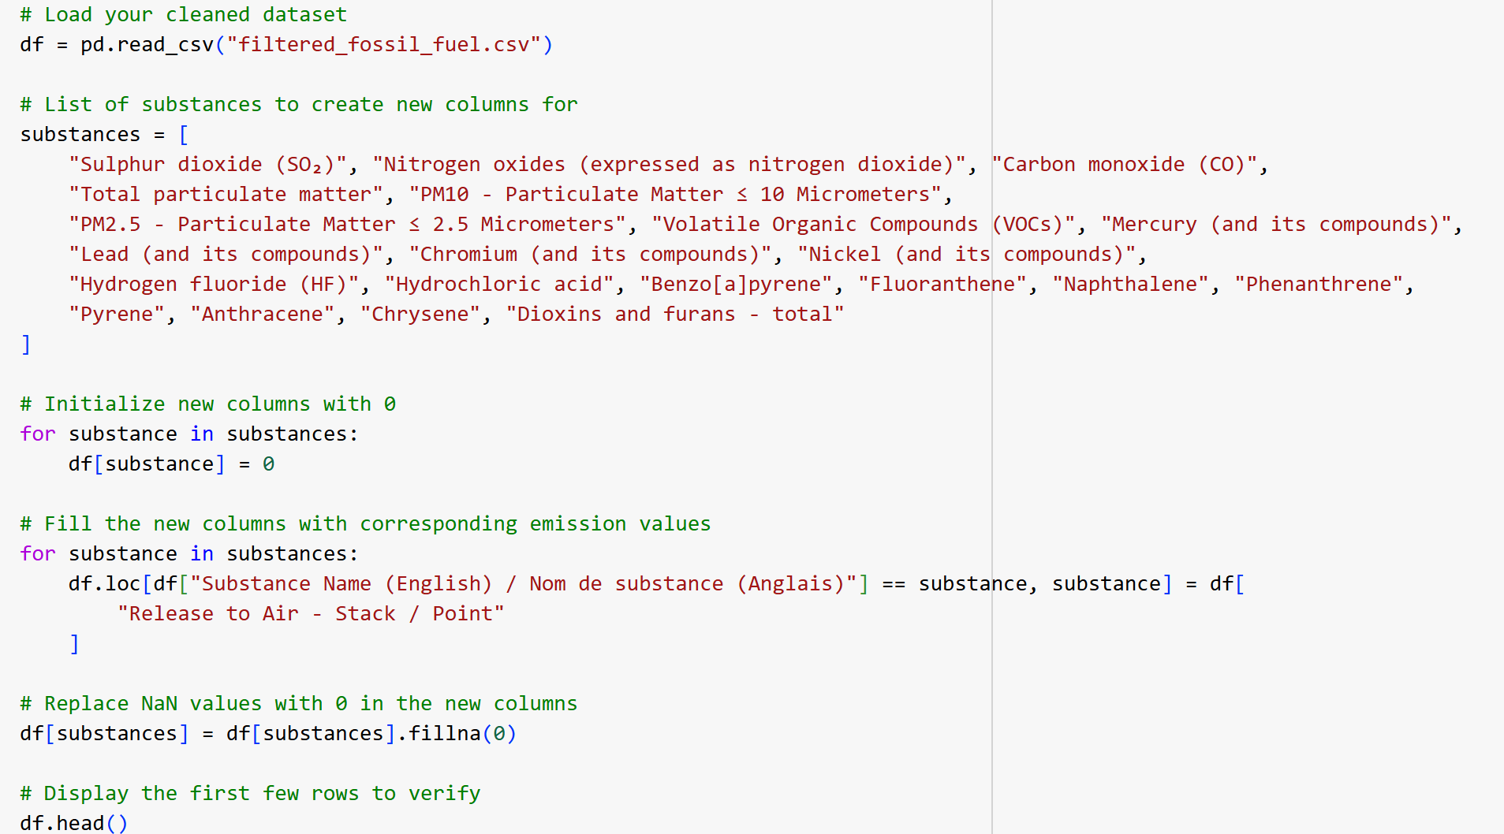
Creating Pollutant-Specific Columns

Slide 6
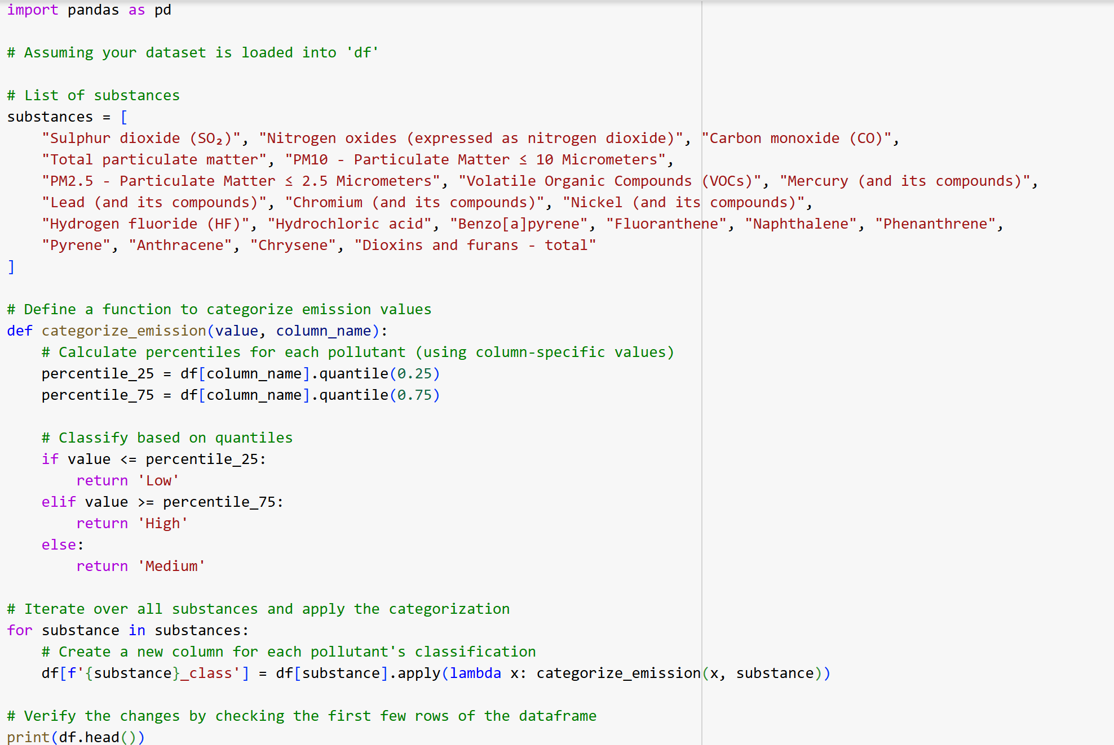
Categorizing Emission Levels

Slide 7
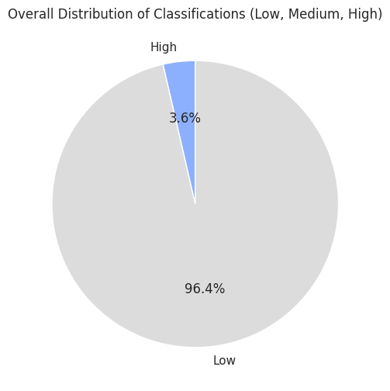
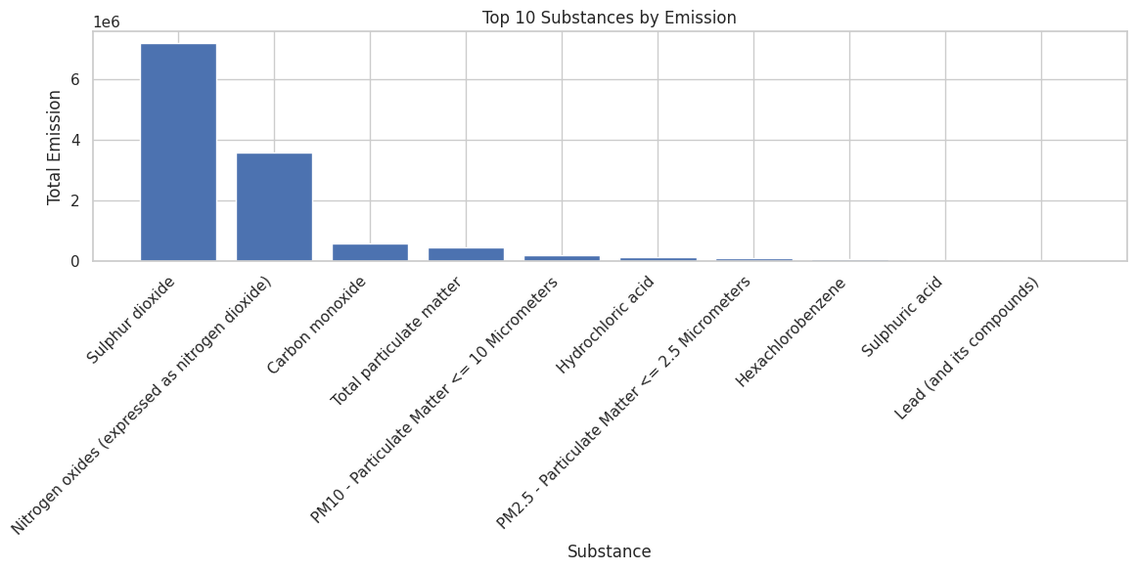

Slide 8
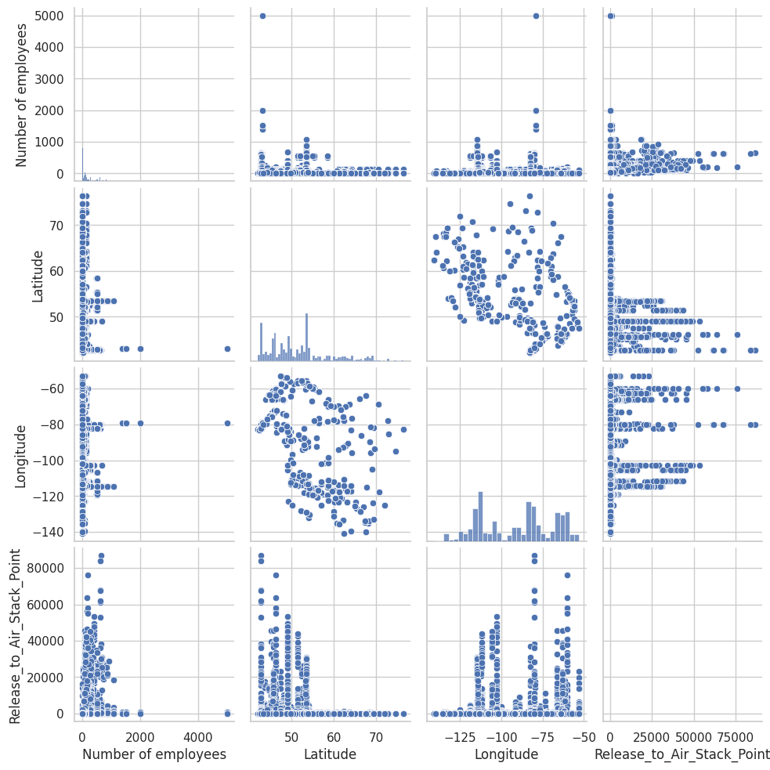
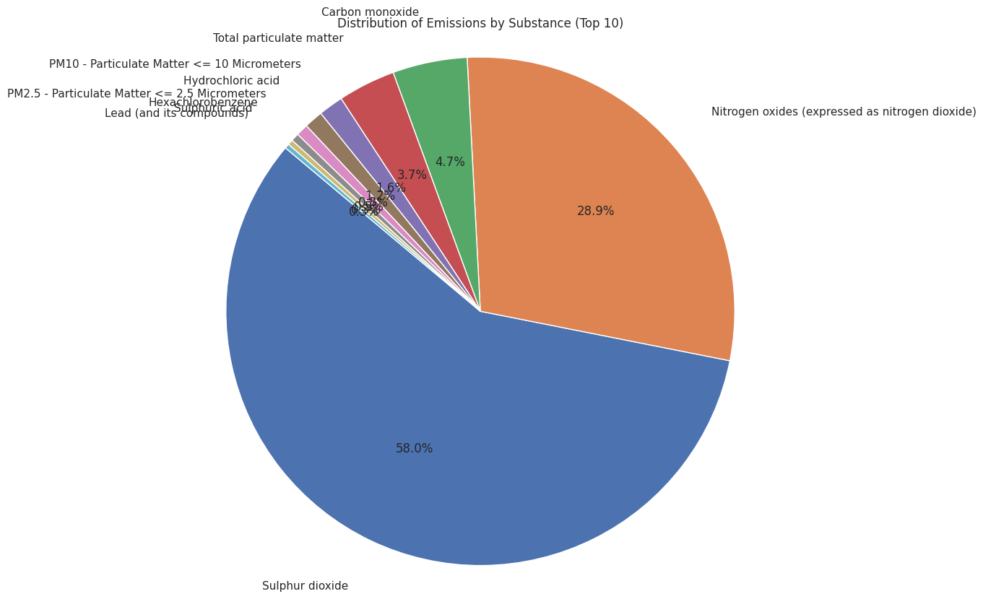
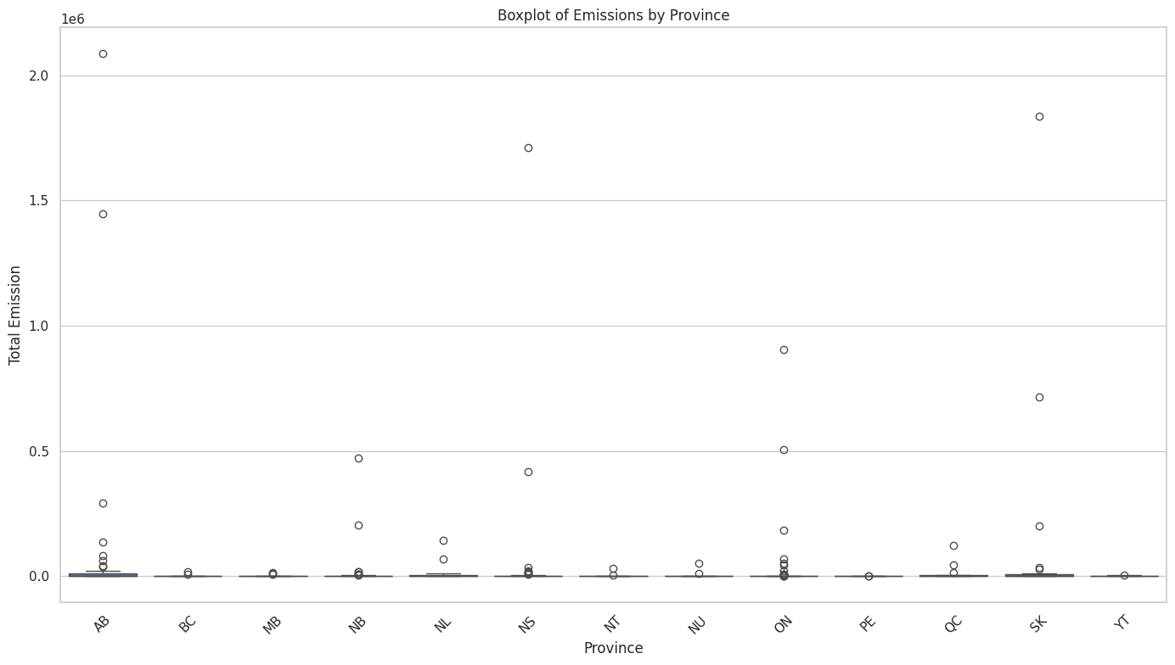

Slide 9
SUMMARY & NEXT STEPS
In summary, we:
Loaded and cleaned the data to remove errors.
Filtered the dataset to focus on fossil-fuel power generation.
Organized emissions data by creating pollutant-specific columns.
Classified pollutants into Low, Medium, or High levels.
These steps allow us to understand pollution trends and make informed decisions about emission regulations.
Next Steps: Exploring machine learning models to predict future emissions trends.

Slide 10
THANK YOU

